Slide 1




Knight-Walk
A short interval connection tool for walking with a group on ODU’s campus
By
Aaron Berman
January 31, 2020
CS 410: Professional Workforce I
Spring 2020

Slide 2
Overview
Problem Description
Why?
Customers, end-users
Potential competitors
Concept /Flow
Technical approach
Challenges
Conclusion
References

Slide 3

Problem Description
Lack of known personal groups
Walking alone
Unlit/dimly lit areas
Low/no population
Police/security response times
Observation skills
This Photo by Unknown Author is licensed under CC BY-NC-ND

Slide 4
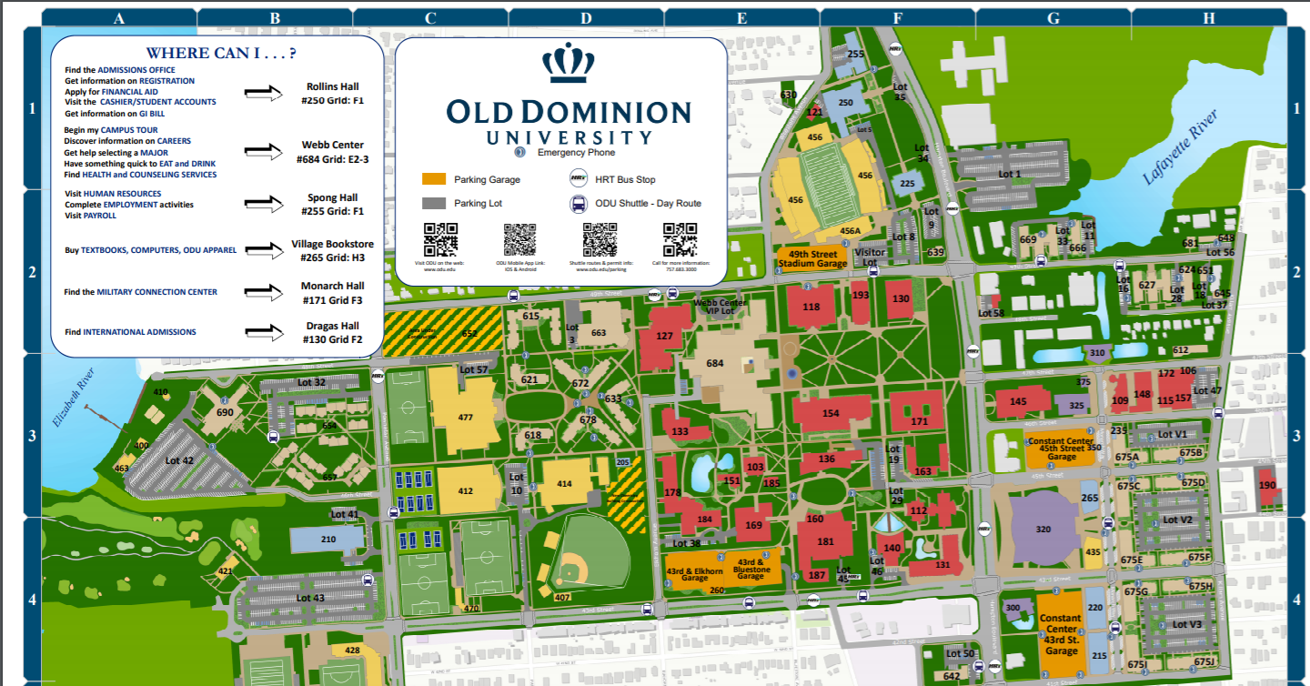
Why?
Campus data for Jan 2020 (Campus Safety Information,2019)
2 Harassments
8 Assaults
1 Stalking
According to stopstreetharrasment.org (Stop Street Harassment, 2020)
The survey found that 65% of all women had experienced street harassment
Among men, 25% had been street harassed
Alone or groups
According to YOUGOV 50% of women say they always or often feel unsafe walking alone at night (YouGov, 2018)
Map of Old Dominion University Campus
( Image Credit: Old Dominion University)
251 Acres and 153 buildings not including eating establishments

Slide 5

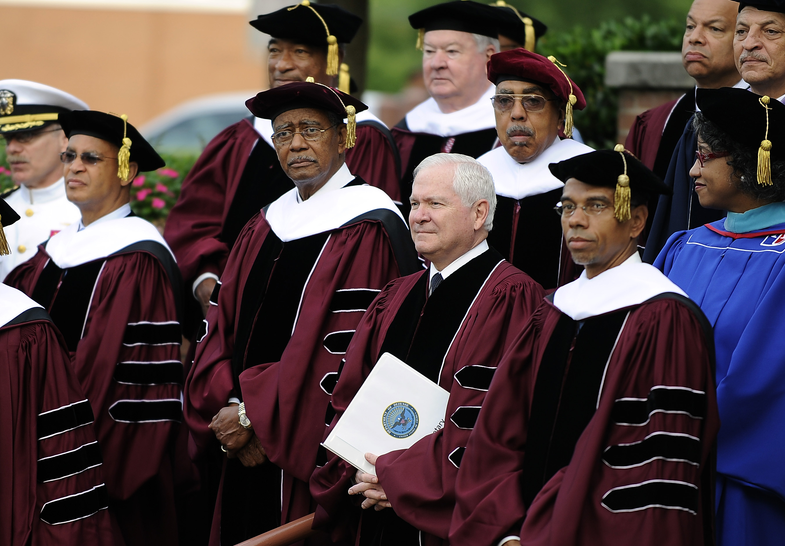
Customers and End-users
Students
Faculty
Those who want to walk in groups
Those who volunteer to walk groups
(This Photo by Unknown Author is licensed under CC BY-NC-ND)
(This Photo by Unknown Author is licensed under CC BY-SA)

Slide 6
Potential Competitors
 | Physical presence | Emergency contact | Police contact | Server side data collection | Video evidence capture
Knight-Walk
ODU LiveSafe (Services and Programs, 2019)
ODU patrol aides (Services and Programs, 2019)
circleof6 (circleof6, 2015)
bsafe (bsafe, 2020)

Slide 7
Concept flow
User opens app
User selects destination from a campus map
User is shown others who are going to the same destination
User selects appropriate group
User joins group
Group travels to destination
User leaves group
User sends request to join group
Normal operation
User is unsafe
User presses PANIC!
Abnormal operation
PANIC! Is pressed.
Campus Police are summoned to geo-location
Other users are notified
Log of people in the group with location and route are stored for police report
Phone camera is enabled and recording for police report
Emergency contact notified

Slide 8
Technical approach
Individual Data
Location
Group Data
Location
Destination
User ID
Destination
Group Member ID data
PANIC!
Log of group data stored
Emergency services called with location
Other users notified
Emergency contact notified
Camera turned on to video and recording
How data is used
Group Data is used for witness ID for the event
Camera footage used for apprehending suspect and evidence
Emergency services and other users notified for potential safeguard measures
Emergency contact to notify someone who help the person feel safer
Phone
Server
Individual Data
Group data
Location of all campus buildings
PANIC! Database
All logs sent to PANIC! server
Everything except logs can be opt out.

Slide 9
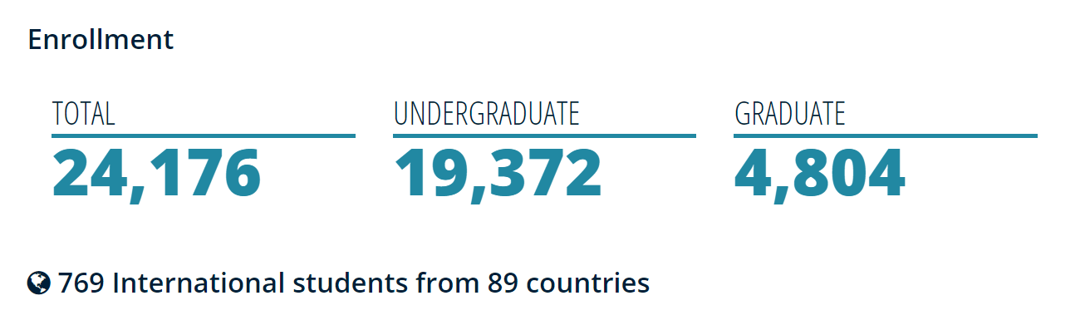
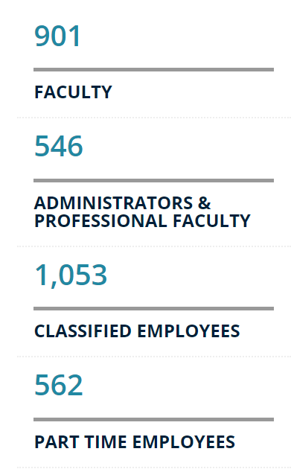
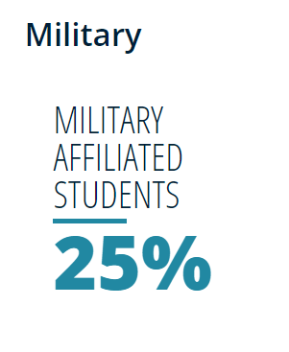
Challenges
FERPA data storage and collection
Privacy
Visualization of users and groups
Adoption
Metrics
(University Facts & Figures, 2019)

Slide 10
Conclusion
What we are
The feeling of safety is paramount in our society
Connecting ad-hoc groups with short duration common interests is important
Physical services are finite
Data capture and redundant storage in emergencies is important
All persons with a @odu.edu email address
Provide real people to walk to destinations with groups
PANIC! Button will actually call for emergency services and other users.

Slide 11

Questions
This Photo by Unknown Author is licensed under CC BY

Slide 12
References
Services and Programs. (09/11/2019). Retrieved from https://www.odu.edu/police/services
Campus Safety Information. (04/06/2019). Retrieved from https://www.odu.edu/police/clery
YouGov. (2018). Retrieved from https://today.yougov.com/topics/lifestyle/articles-reports/2019/03/28/women-safety-sexual-assault-awareness
Stop Street Harassment. (2020). Retrieved from http://www.stopstreetharassment.org/resources/statistics/statistics-academic-studies/
Circleof6. (2015). Retrieved from https://www.circleof6app.com/
bsafe. (2020). Retrieved from https://www.getbesafe.com
University Facts & Figures. (11/09/2019). Retrieved from https://www.odu.edu/about/facts-and-figures

